Slide 1

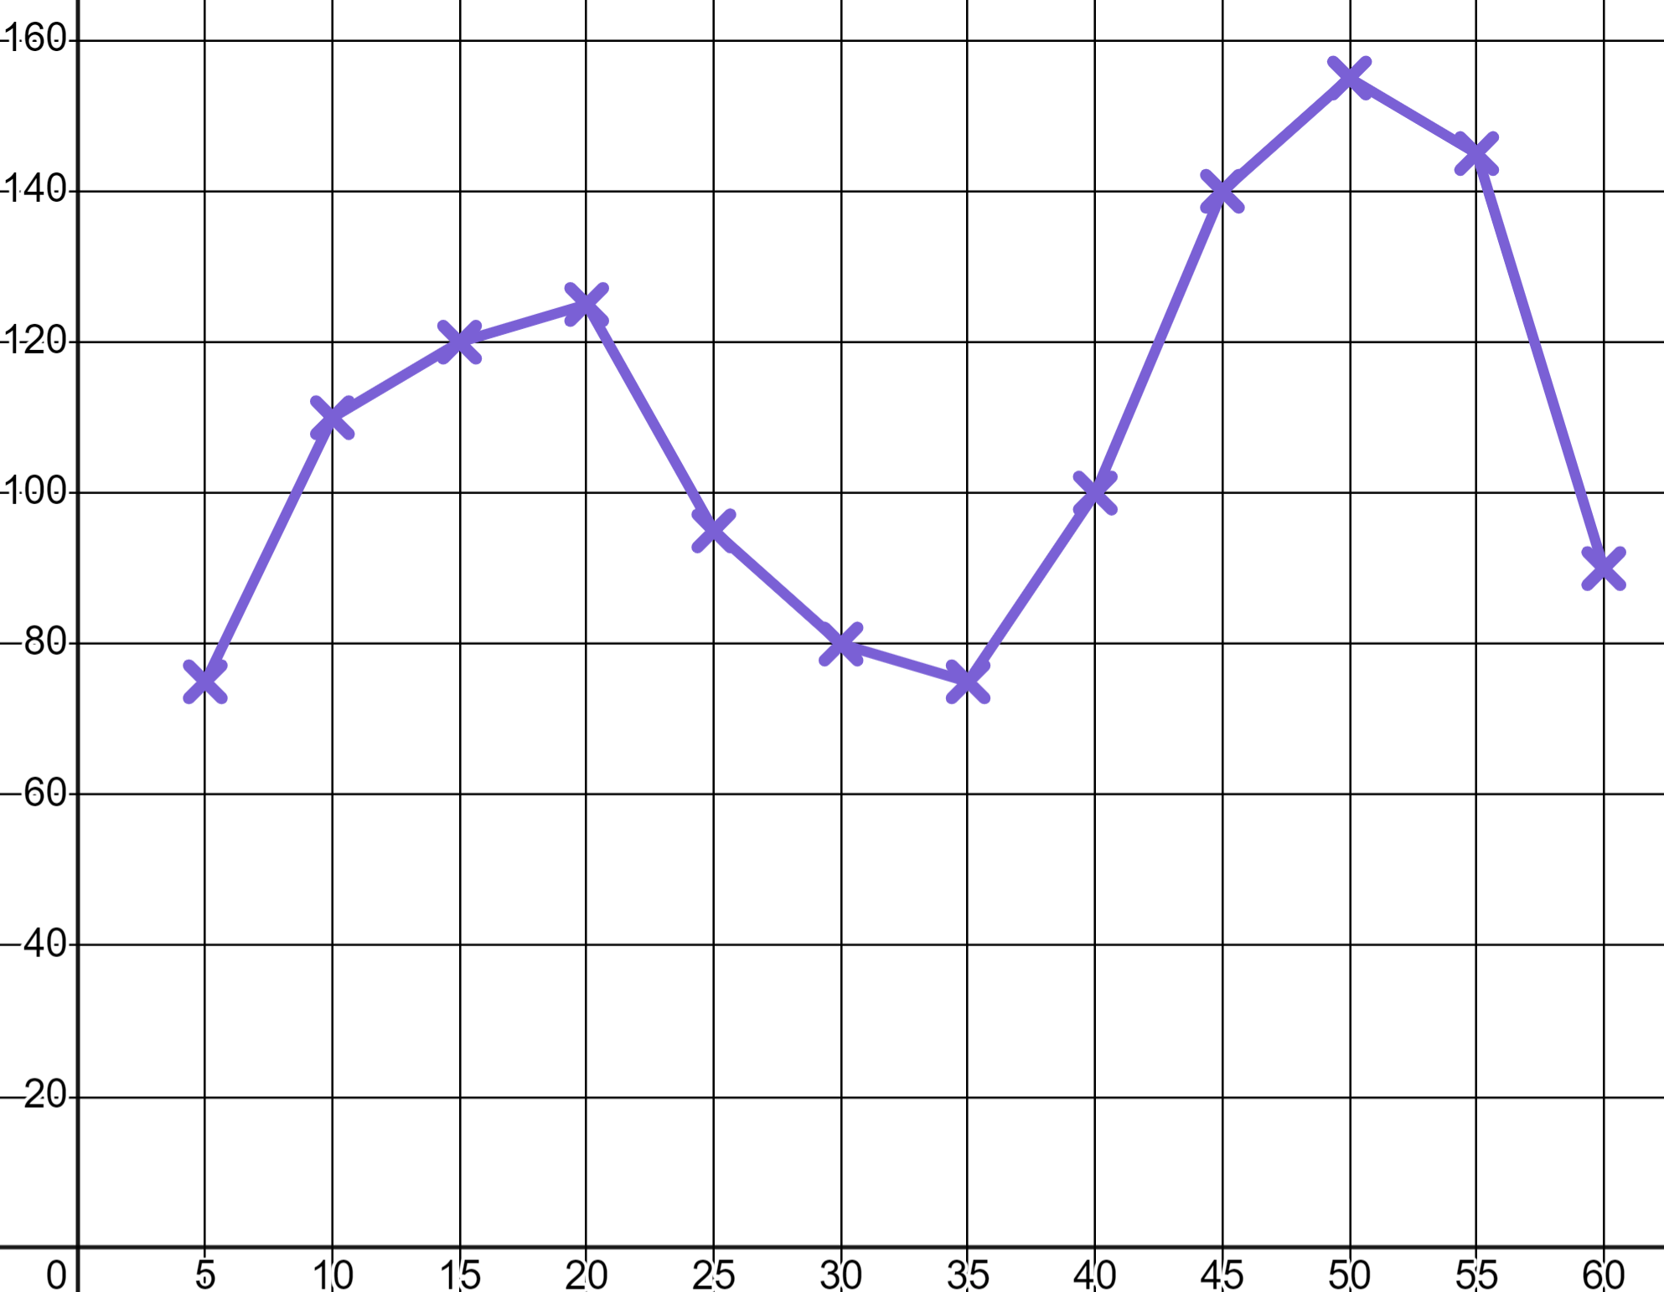
Sports coaching
Task A: Recording and using data
1) a) Jacob goes skateboarding and his watch records his b.p.m.
Write at least three sentences to describe Jacob’s skating session. Use words like ‘moderate intensity’ and ‘high intensity’.
b.p.m.
T (min)
You might have written: “Jacob spent the first 20 minutes skating at a moderate intensity. He then had a period of rest. He finished with a period of high intensity where his heart rate was at its max”.
b) Rank these three moments with a numerical value from the trainers’ RPE chart.
RPE Chart (Rate of perceived exertion)
10 | Max effort | Impossible to continue Out of breath Unable to talk
9 | Very hard | Hard to maintain Can barely breathe Speaking single words
7-8 | Vigorous | Verge of uncomfortable Short of breath, single sentences
4-6 | Moderate | Could continue for hours Breathing heavy, short conversation
2-3 | Light | Easy to maintain for hours Can maintain conversation easily
1 | Very light | Anything other than sleeping e.g. Sitting watching T.V.
7 or 8
b.p.m.
4 to 6
1
T (min)

Slide 2


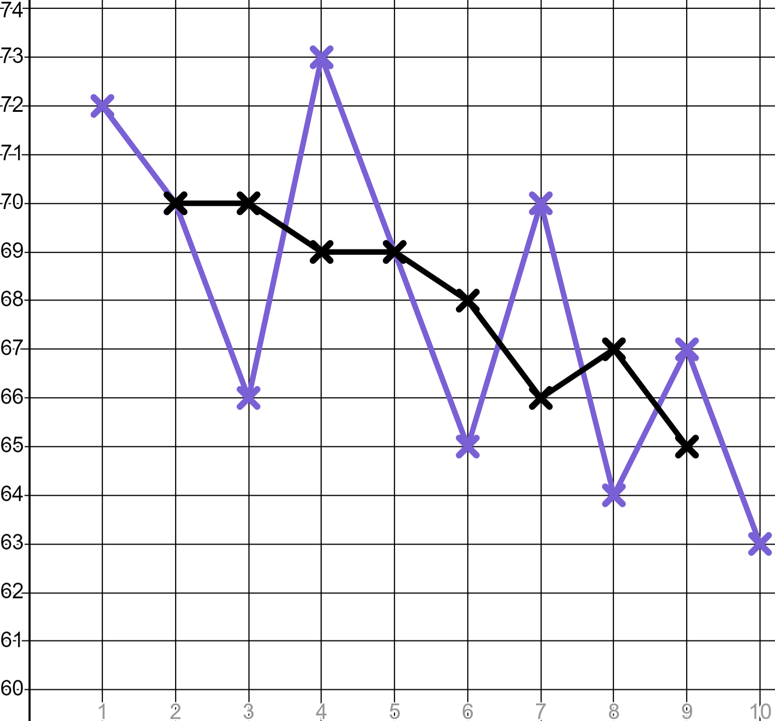
Sports coaching
2) Sporty Sofia is filling in a target heart rate chart for older members of her family to use whilst exercising.
Your maximum heart rate is 220 b.p.m. minus age
Target heart rate for moderate exercise is 50 − 70% of maximum
Target heart rate for high intensity exercise is 70 − 85% of maximum
Age | Moderate exercise min | High intensity starts | High intensity max
20 | 100 | 140 | 170
30 | 95 | 133 | 161.5
50 | 85 | 119 | 144.5
70 | 75 | 105 | 127.5
Fill in the blanks in the table.
3) Aisha is trying to improve her 400 metre time. Here are her best times over 10 weeks of training.
Week | 1 | 2 | 3 | 4 | 5 | 6 | 7 | 8 | 9 | 10
Time (sec) | 73 | 70 | 66 | 73 | 69 | 65 | 70 | 64 | 67 | 63
Athletic Aisha
a) Calculate the mean, mode and median of her times.
Mode: 70 sec
Median: 68 sec
Mean: 67.9 sec
b) Write a sentence explaining why these three averages alone do not inform you as to whether Aisha is improving.
You might have said, “These averages are calculated over the whole ten weeks. They give us important information but show nothing about progress over time.”
c) Populate the table of three-point moving averages (to the nearest whole number). The first one is done for you.
Week | 1 | 2 | 3 | 4 | 5 | 6 | 7 | 8 | 9 | 10
Time (sec) | 73 | 70 | 66 | 73 | 69 | 65 | 70 | 64 | 67 | 63
 | ✖ | 70 | 70 | 69 | 69 | 68 | 66 | 67 | 65 | ✖
d) Graph Aisha’s three-point moving averages and write a comment as to whether she is improving.
You might have said, “Aisha’s three-point moving averages are trending downwards; she is improving.”
Time (s)
e) Use your three-point moving averages to make a prediction as to when Aisha might break the 60 second barrier.
You might have said, “Aisha’s three-point moving averages are improving by approximately half a second per week. If this trend continues she should break the 60 second barrier in another ten weeks.”
Wk
‹#›

Slide 3

Sports coaching
Task B: Using data to plan training sessions
Training Goal | Sets | Reps | Rest Period | Intensity
Endurance | 3 - 4 | > 12 | Up to 30 seconds | < 67% of 1RM
Muscle leanness | 3 - 6 | 6 - 12 | 30 to 90 seconds | 67 - 85% of 1RM
Muscle strength | 4 - 6 | < 6 | 2 to 5 minutes | > 85% of 1RM
1) Sofia’s older brother is training for a heptathlon therefore he needs to develop muscle leanness. He is working on his bench press and has a 1RM of 80 kg. Create for him a:
a) Starter plan
b) Improver plan
c) Expert plan
Intensity:
70% × 80 = 56 kg
75% × 80 = 60 kg
75% × 80 = 60 kg
Sets/Reps:
3 sets of 6 reps
3 sets of 6 reps
6 sets of 12 reps
Rest periods:
90 seconds
90 seconds
30 seconds
This is not the only solution. Your solution should start at the easier ends of the bounds and progress to greater difficulty.
2) a) Someone with a 1RM of 125 kg in deadlifting is doing reps of 76 kg. What is their training goal?
Intensity < 67% kg therefore training for endurance.
b) Someone tells you they did 60 repetitions across all of their sets. What could their training goal be?
6 × 5 = 30 is the max reps for muscle strength so this can not be that.
4 sets of 15 reps is training for endurance.
3 sets of 20 reps is training for endurance.
6 sets of 10 reps is training for muscle leanness.
5 sets of 12 reps is training for muscle leanness.
c) Someone tells you they are intensely training for muscle leanness and are deadlifting 136 kg. What is their 1RM?
Most intense level for muscle leanness is 85% of their 1RM
1RM × 0.85 = 136 kg therefore…
136 kg ÷ 0.85 = 160 kg
Mathematics in Education and Industry
v2.4

